Slide 1


Sensitivity Analysis of the Maximum Matching Problem
Yuichi Yoshida
Samson Zhou

Slide 2

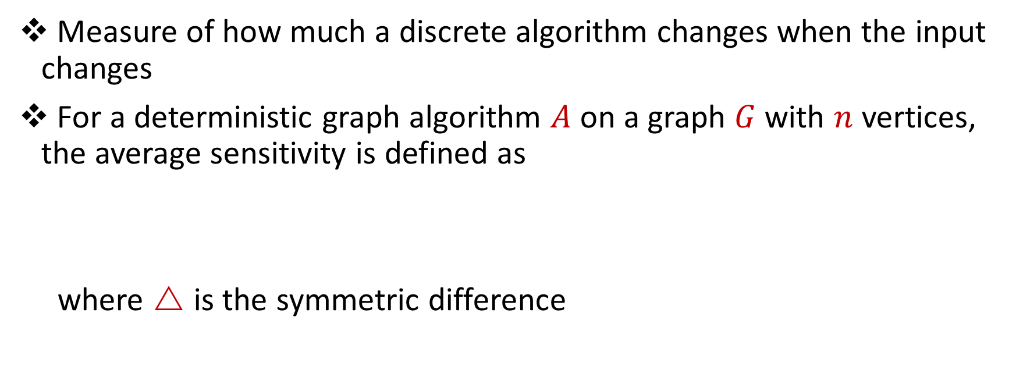
Average Sensitivity for Graph Algorithms
Measure of how much a discrete algorithm changes when the input changes
For a deterministic graph algorithm $A$ on a graph $G$ with $n$ vertices, the average sensitivity is defined as
where $$ is the symmetric difference
$$\underset{e∼E(G)}{E}\left[\left|A(G)ρA\left(G−e\right)\right|\right]$$

Slide 3

Average Sensitivity for Graph Algorithms
Example: Greedy algorithm for maximal matching on graph with $6$ nodes

Slide 4

Average Sensitivity for Graph Algorithms
Example: Greedy algorithm for maximal matching on graph with $6$ nodes

Slide 5
Average Sensitivity for Graph Algorithms
Example: Greedy algorithm for maximal matching on graph with $6$ nodes

Slide 6
Average Sensitivity for Graph Algorithms
Example: Greedy algorithm for maximal matching on graph with $6$ nodes

Slide 7
Average Sensitivity for Graph Algorithms
Example: Greedy algorithm for maximal matching on graph with $6$ nodes

Slide 8
Average Sensitivity for Graph Algorithms
Example: Greedy algorithm for maximal matching on graph with $6$ nodes

Slide 9
Average Sensitivity for Graph Algorithms
Example: Greedy algorithm for maximal matching on graph with $6$ nodes

Slide 10
Average Sensitivity for Graph Algorithms
Example: Greedy algorithm for maximal matching on graph with $6$ nodes

Slide 20

Average Sensitivity for Graph Algorithms
Example: Greedy algorithm for maximum matching on graph with $6$ nodes
$\left|A(G)ρA\left(G−e\right)\right|=3$

Slide 21
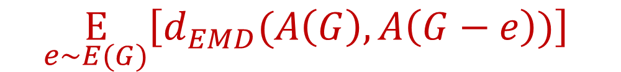
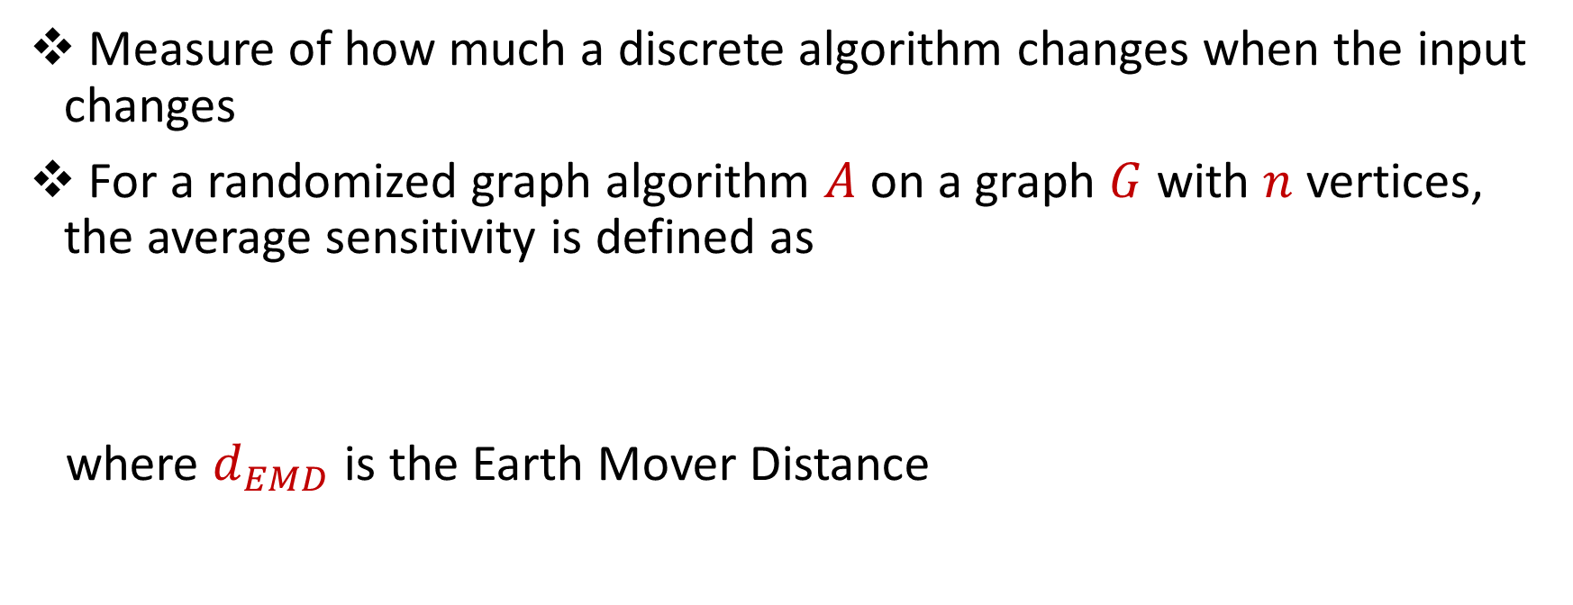
Average Sensitivity for Graph Algorithms
Measure of how much a discrete algorithm changes when the input changes
For a randomized graph algorithm $A$ on a graph $G$ with $n$ vertices, the average sensitivity is defined as
where $d_{EMD}$ is the Earth Mover Distance
$$\underset{e∼E(G)}{E}\left[d_{EMD}(A\left(G\right),A\left(G−e\right))\right]$$

Slide 22



Slide 28

Average Sensitivity for Graph Algorithms
Introduced by Murai and Yoshida [MY19] for centrality
harmonic centrality
betweenness centrality
closeness centrality
spanning tree centrality
PageRank

Slide 29
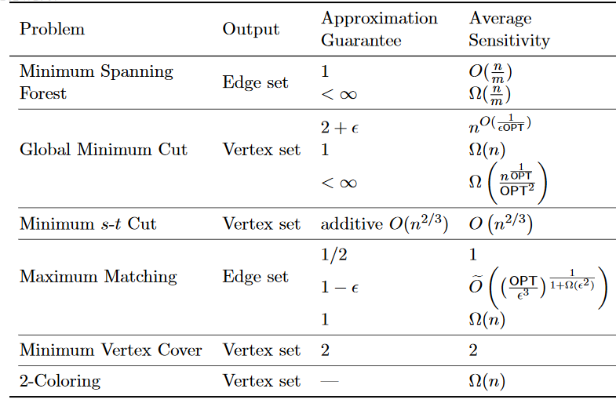
Average Sensitivity for Graph Algorithms
Introduced by Murai and Yoshida [MY19] for centrality
Varma and Yoshida [VY21] for graph algorithms that output edge/vertex sets

Slide 30
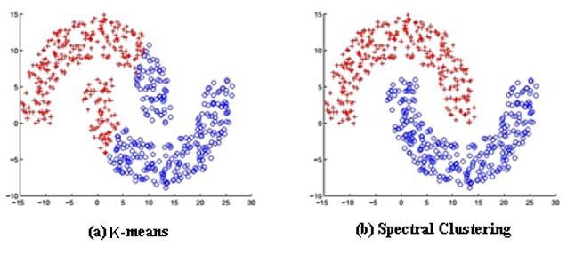
Average Sensitivity for Graph Algorithms
Introduced by Murai and Yoshida [MY19] for centrality
Varma and Yoshida [VY21] for graph algorithms that output edge/vertex sets
Peng and Yoshida [PY20] for spectral clustering

Slide 31
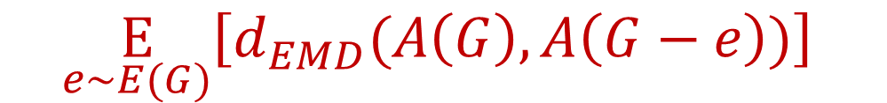
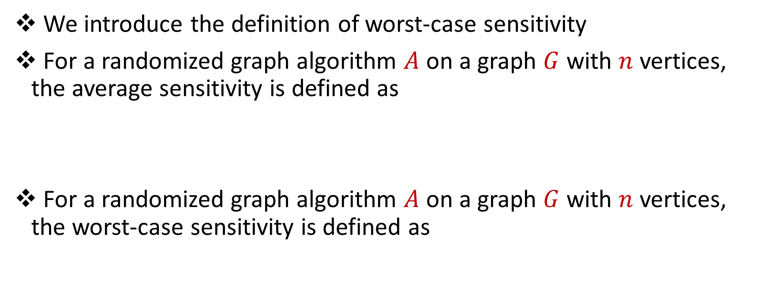
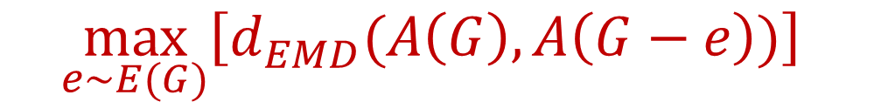
From Average Sensitivity to Worst-Case Sensitivity
We introduce the definition of worst-case sensitivity
For a randomized graph algorithm $A$ on a graph $G$ with $n$ vertices, the average sensitivity is defined as
For a randomized graph algorithm $A$ on a graph $G$ with $n$ vertices, the worst-case sensitivity is defined as
$$\underset{e∼E(G)}{E}\left[d_{EMD}(A\left(G\right),A\left(G−e\right))\right]$$
$$\max_{e∼E(G)}\left[d_{EMD}(A\left(G\right),A\left(G−e\right))\right]$$

Slide 32
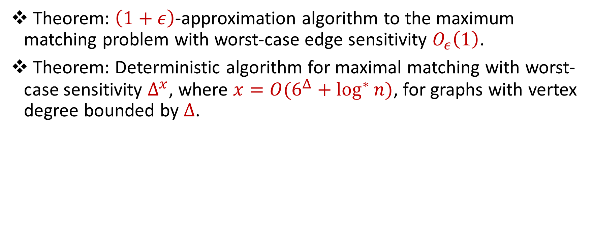
Our Results (1)
Theorem: $\left(1+ε\right)$-approximation algorithm to the maximum matching problem with worst-case edge sensitivity $O_{ε}\left(1\right)$.
Theorem: Deterministic algorithm for maximal matching with worst-case sensitivity $Δ^{x}$, where $x=O(6^{Δ}+\log^{∗}{n)}$, for graphs with vertex degree bounded by $Δ$.

Slide 33
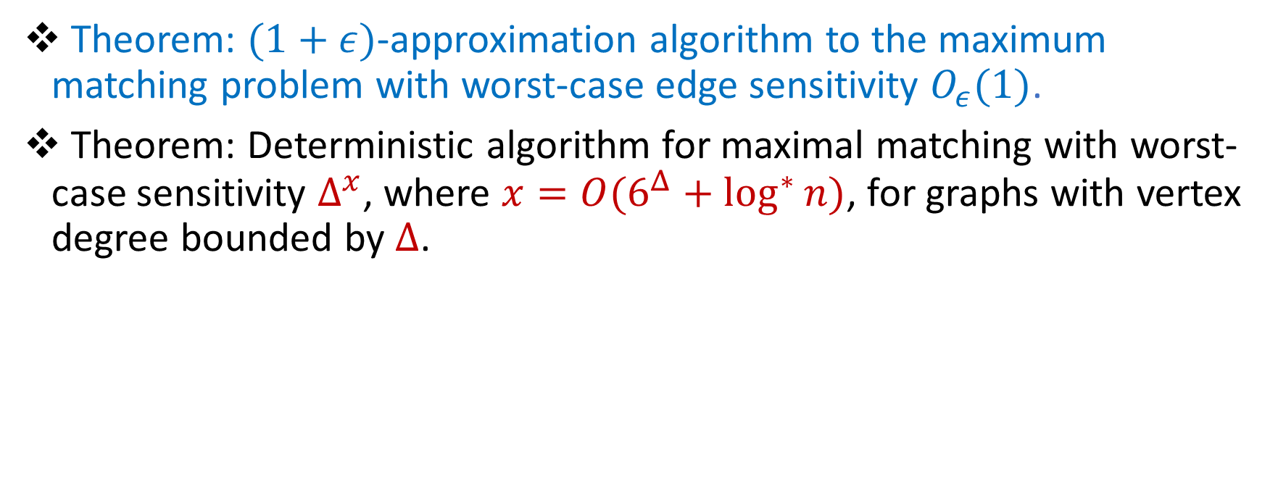
Our Results (1)
Theorem: $(1+ε)$-approximation algorithm to the maximum matching problem with worst-case edge sensitivity $O_{ε}(1)$.
Theorem: Deterministic algorithm for maximal matching with worst-case sensitivity $Δ^{x}$, where $x=O(6^{Δ}+\log^{∗}{n)}$, for graphs with vertex degree bounded by $Δ$.

Slide 34
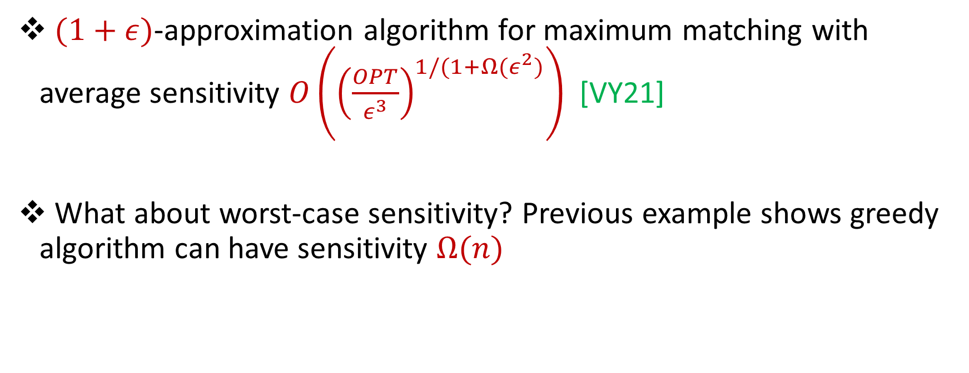
Maximum Matching
$(1+ε)$-approximation algorithm for maximum matching with average sensitivity $O\left({\left(\frac{OPT}{ε^{3}}\right)}^{1/(1+Ω(ε^{2})}\right)$ [VY21]
What about worst-case sensitivity? Previous example shows greedy algorithm can have sensitivity $Ω(n)$

Slide 35
Maximal Matching
First idea: Randomized greedy for maximal matching
The “expected” deleted/added edge appears halfway through the ordering of edges
Intuition: Either most of the edges in the matching occur early in the ordering (dense graph) OR the deleted/added edge does not affect edges in the matching (sparse graph)

Slide 36
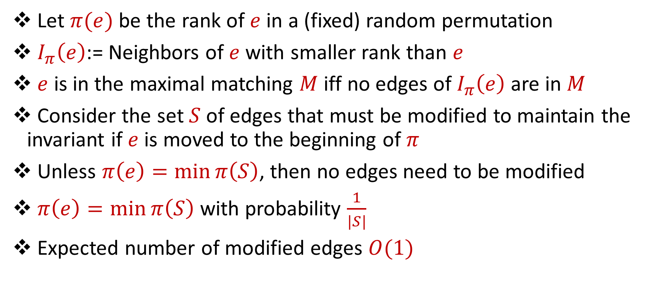
Randomized greedy for maximal matching
Let $π(e)$ be the rank of $e$ in a (fixed) random permutation
$I_{π}\left(e\right)$:= Neighbors of $e$ with smaller rank than $e$
$e$ is in the maximal matching $M$iff no edges of $I_{π}\left(e\right)$ are in $M$
Consider the set $S$ of edges that must be modified to maintain the invariant if $e$ is moved to the beginning of $π$
Unless $π\left(e\right)=\min{π\left(S\right)}$, then no edges need to be modified
$π\left(e\right)=\min{π\left(S\right)}$ with probability $\frac{1}{|S|}$
Expected number of modified edges $O(1)$

Slide 37
Randomized greedy for maximal matching
Similar idea used for maximal independent set in the dynamic distributed setting [CHK16]
Let $π(e)$ be the rank of $e$ in a (fixed) random permutation
$I_{π}\left(e\right)$:= Neighbors of $e$ with smaller rank than $e$
$e$ is in the maximal matching $M$iff no edges of $I_{π}\left(e\right)$ are in $M$
Consider the set $S$ of edges that must be modified to maintain the invariant if $e$ is moved to the beginning of $π$
Unless $π\left(e\right)=\min{π\left(S\right)}$, then no edges need to be modified
$π\left(e\right)=\min{π\left(S\right)}$ with probability $\frac{1}{|S|}$
Expected number of modified edges $O(1)$

Slide 38
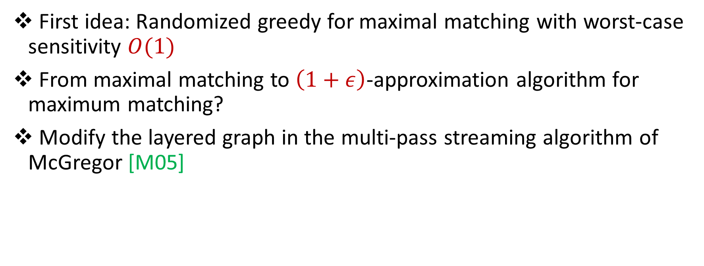
Step 1: Maximal Matching
First idea: Randomized greedy for maximal matching with worst-case sensitivity $O(1)$
From maximal matching to $\left(1+ε\right)$-approximation algorithm for maximum matching?
Modify the layered graph in the multi-pass streaming algorithm of McGregor [M05]

Slide 39
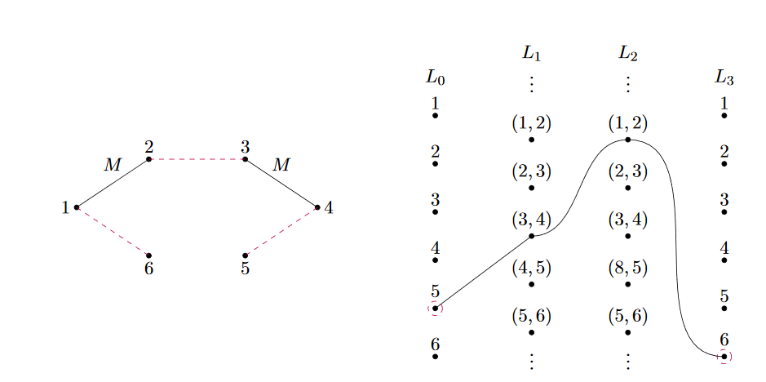
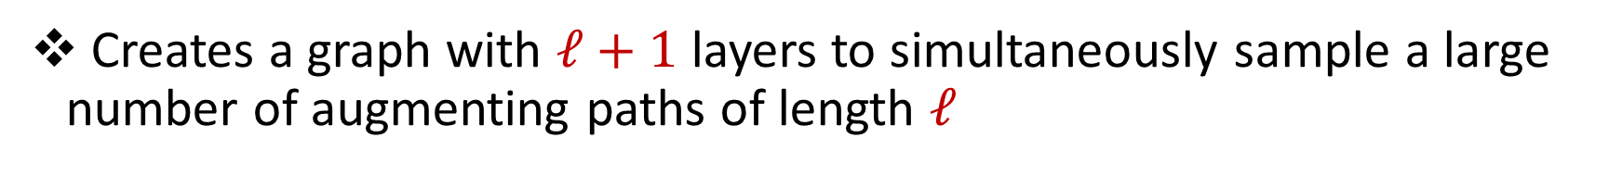
Step 2: Layered Graph
Creates a graph with $ℓ+1$ layers to simultaneously sample a large number of augmenting paths of length $ℓ$

Slide 40
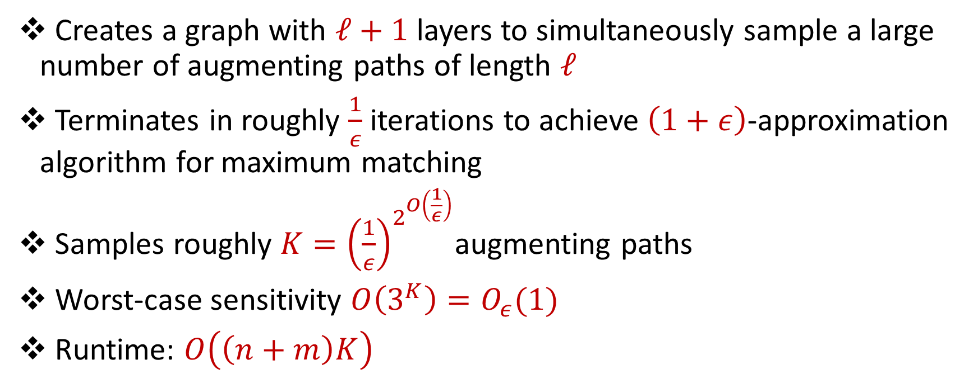
Step 2: Layered Graph
Creates a graph with $ℓ+1$ layers to simultaneously sample a large number of augmenting paths of length $ℓ$
Terminates in roughly $\frac{1}{ε}$ iterations to achieve $\left(1+ε\right)$-approximation algorithm for maximum matching
Samples roughly $K={\left(\frac{1}{ε}\right)}^{2^{O\left(\frac{1}{ε}\right)}}$augmenting paths
Worst-case sensitivity $O\left(3^{K}\right)=O_{ε}(1)$
Runtime: $O\left(\left(n+m\right)K\right)$

Slide 41
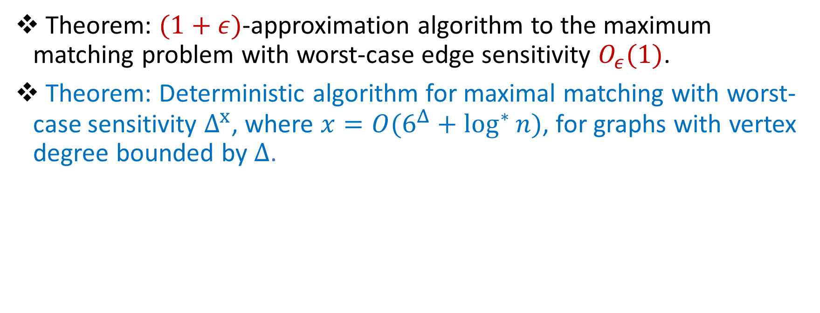
Our Results (1)
Theorem: $(1+ε)$-approximation algorithm to the maximum matching problem with worst-case edge sensitivity $O_{ε}(1)$.
Theorem: Deterministic algorithm for maximal matching with worst-case sensitivity $Δ^{x}$, where $x=O(6^{Δ}+\log^{∗}{n)}$, for graphs with vertex degree bounded by $Δ$.

Slide 42
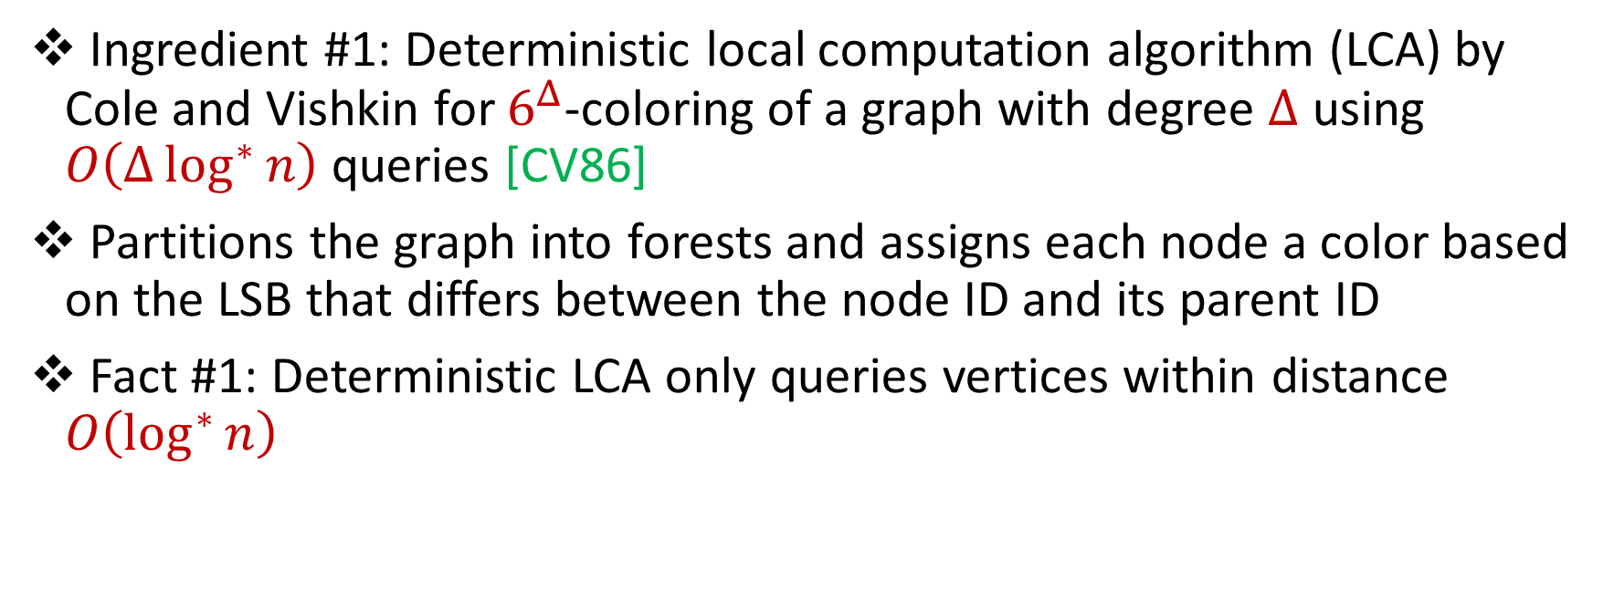
Deterministic Algorithm
Ingredient #1: Deterministic local computation algorithm (LCA) by Cole and Vishkin for $6^{Δ}$-coloring of a graph with degree $Δ$ using $O\left(Δ\log^{∗}{n}\right)$ queries [CV86]
Partitions the graph into forests and assigns each node a color based on the LSB that differs between the node ID and its parent ID
Fact #1: Deterministic LCA only queries vertices within distance $O\left(\log^{∗}{n}\right)$

Slide 43
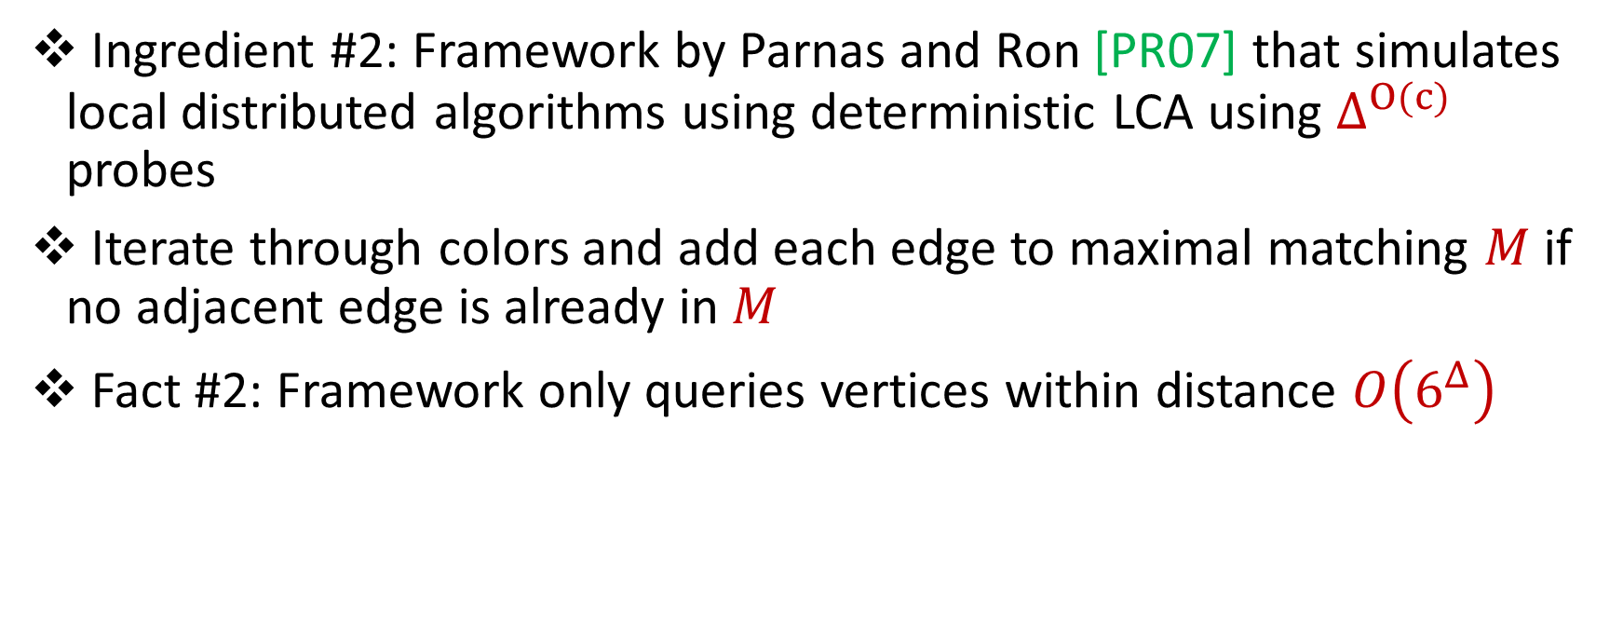
Deterministic Algorithm
Ingredient #2: Framework by Parnas and Ron [PR07] that simulates local distributed algorithms using deterministic LCA using $Δ^{O(c)}$ probes
Iterate through colors and add each edge to maximal matching $M$ if no adjacent edge is already in $M$
Fact #2: Framework only queries vertices within distance $O\left(6^{Δ}\right)$

Slide 44
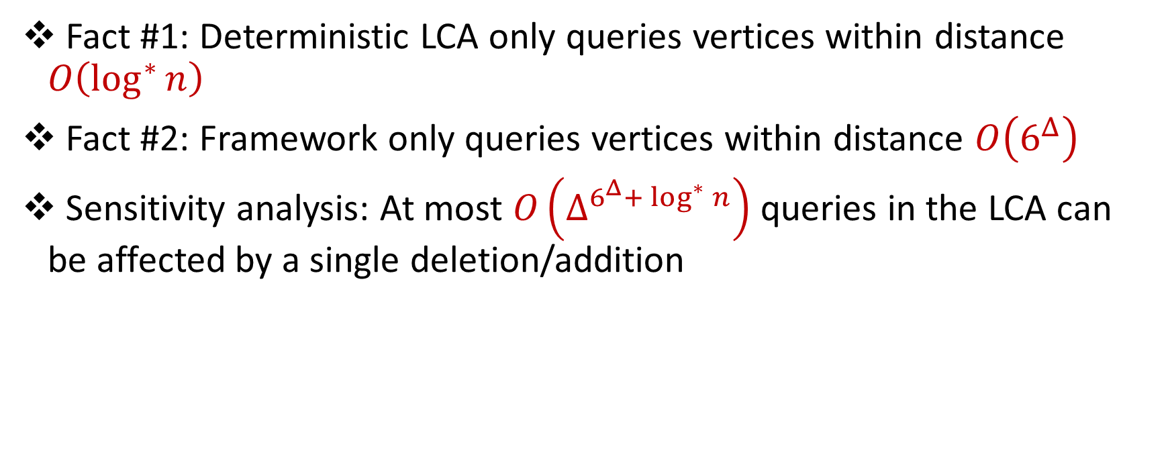
Deterministic Algorithm
Fact #1: Deterministic LCA only queries vertices within distance $O\left(\log^{∗}{n}\right)$
Fact #2: Framework only queries vertices within distance $O\left(6^{Δ}\right)$
Sensitivity analysis: At most $O\left(Δ^{6^{Δ}+ \log^{∗}{n}}\right)$ queries in the LCA can be affected by a single deletion/addition

Slide 45
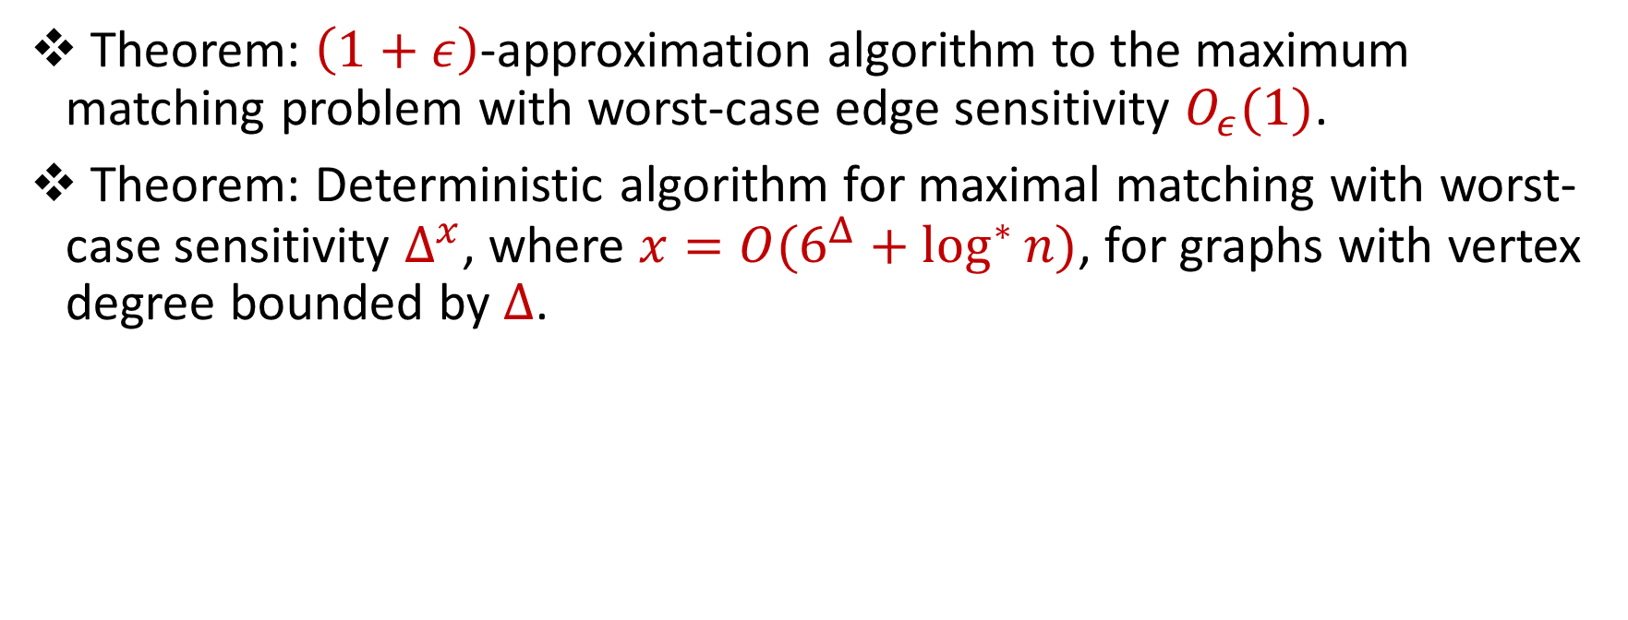
Our Results (1)
Theorem: $\left(1+ε\right)$-approximation algorithm to the maximum matching problem with worst-case edge sensitivity $O_{ε}(1)$.
Theorem: Deterministic algorithm for maximal matching with worst-case sensitivity $Δ^{x}$, where $x=O(6^{Δ}+\log^{∗}{n)}$, for graphs with vertex degree bounded by $Δ\text{.}$

Slide 46
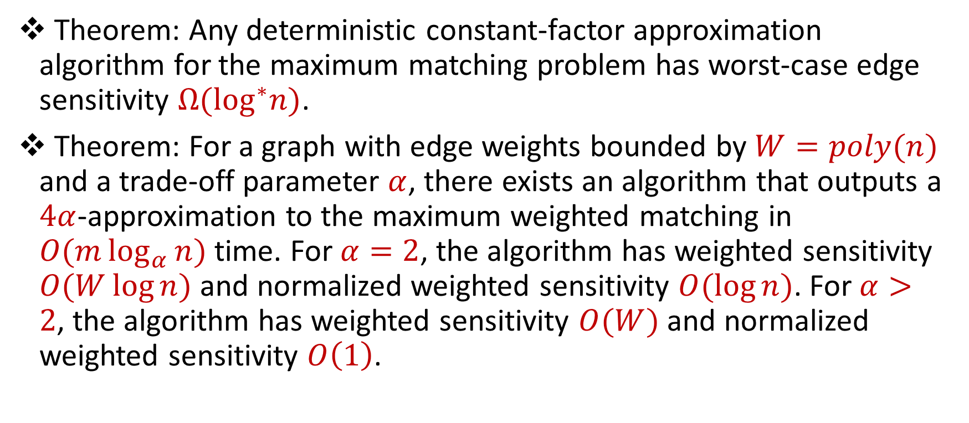
Our Results (2)
Theorem: Any deterministic constant-factor approximation algorithm for the maximum matching problem has worst-case edge sensitivity $Ω(\log^{∗}n)$.
Theorem: For a graph with edge weights bounded by $W=poly(n)$ and a trade-off parameter $α$, there exists an algorithm that outputs a $4α$-approximation to the maximum weighted matching in $O(m\log_{α}{n)}$ time. For $α=2$, the algorithm has weighted sensitivity $O(W\log{n) }$and normalized weighted sensitivity $O(\log{n)}$. For $α>2$, the algorithm has weighted sensitivity $O(W)$ and normalized weighted sensitivity $O\left(1\right)$.

Slide 47
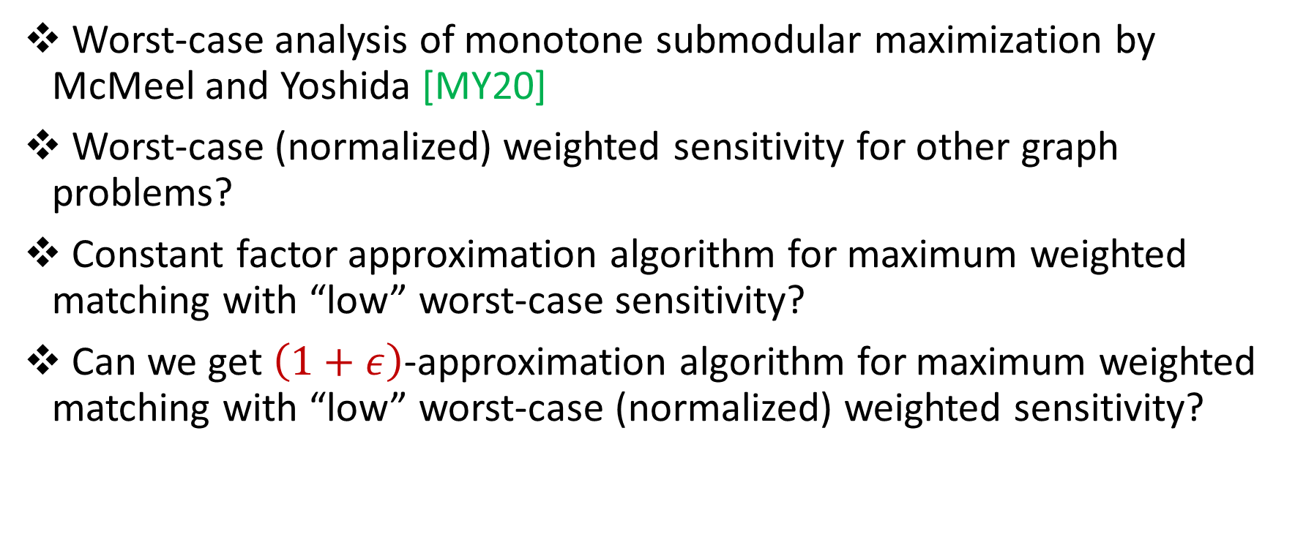
Future Directions
Worst-case analysis of monotone submodular maximization by McMeel and Yoshida [MY20]
Worst-case (normalized) weighted sensitivity for other graph problems?
Constant factor approximation algorithm for maximum weighted matching with “low” worst-case sensitivity?
Can we get $\left(1+ε\right)$-approximation algorithm for maximum weighted matching with “low” worst-case (normalized) weighted sensitivity?

Slide 48
